Slide 1
Using PreTeXt to produce a better online text (or lab manual)
Hey, Physicists! There’s a cool tool that allows you to create an online document that does what an online document ought to do!
Joe Christensen
Thomas More College
Crestview Hills, KY

Slide 2
Current online books…
Designed to be printed
Publisher “bookshelf”
myMathLab
Displayed online, not designed for online
Online Options
cK-12: https://www.ck12.org/c/physics/#/
Video, simulations, practice, etc
OpenStax CNX: https://cnx.org/contents/Ax2o07Ul@9.99:HR_VN3f7@3/Introduction-to-Science-and-th

Slide 3
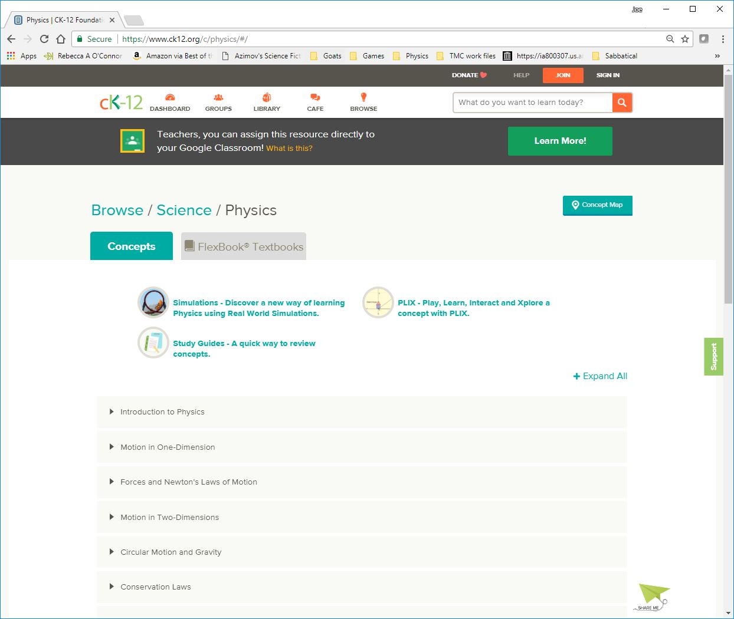
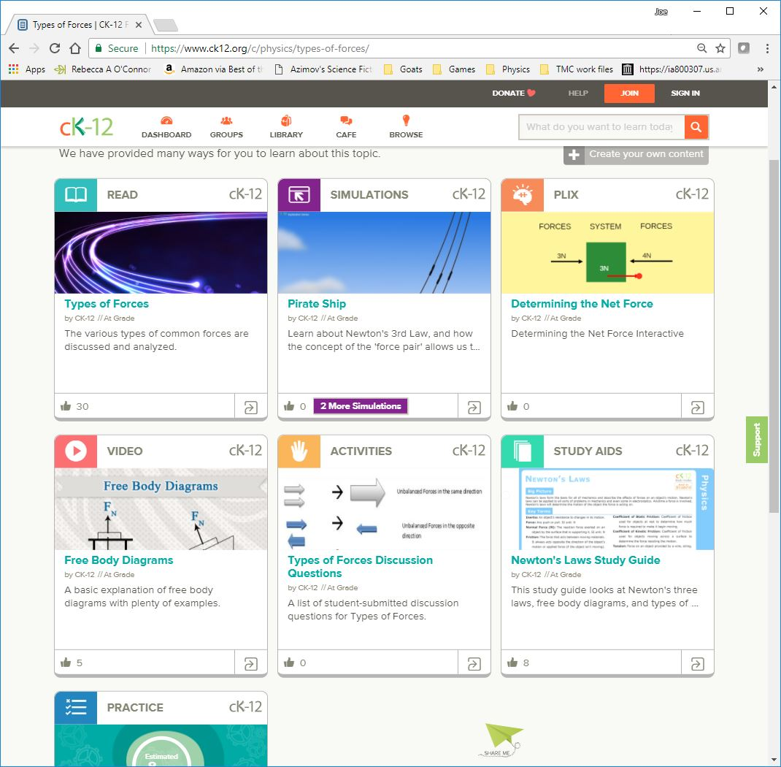

Slide 4
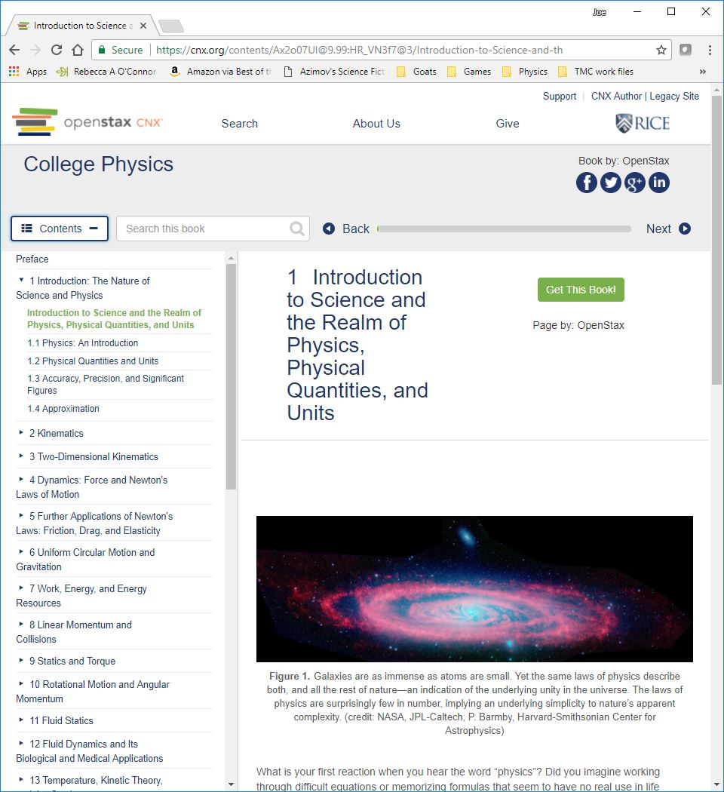

Slide 5
Where online books could be…
Create convertible: PDF can be print and online
External and internal links
Remember when…
Looking ahead…
Clarification, Definition, Etymology of key words
Expandable (?) examples and “interesting boxes”
Constructivism examples
Choose your own adventure
In Real Life explorations
Embedded features (Online, links for PDF)
Embedded video
Physlets, PhETs, other simulations

Slide 6
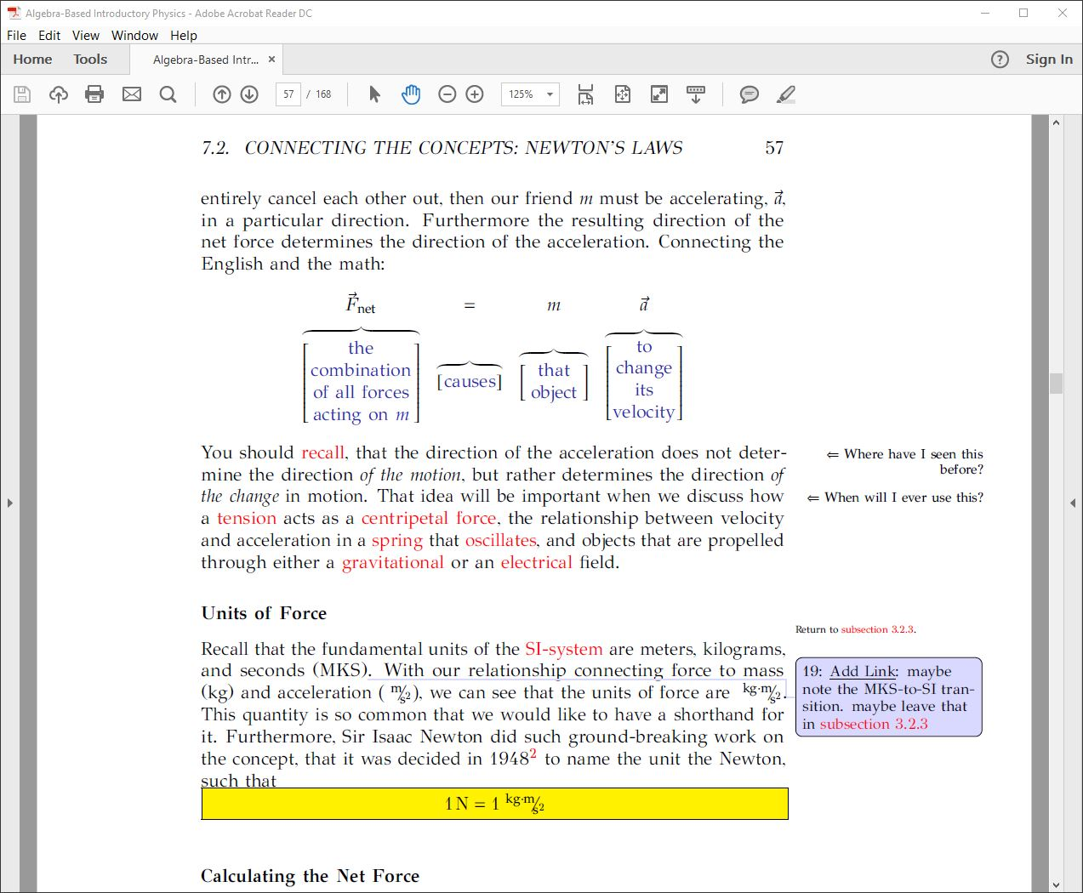
Using LaTeX gets us pretty far…

Slide 7
Where online books could be…
Create convertible: PDF can be print and online
External and internal links
Clarification, Definition, Etymology of key words
Remember when…
Looking ahead…
Expandable (?) examples and “interesting boxes”
Constructivism examples
Choose your own adventure
In Real Life explorations
Embedded features (Online, links for PDF)
Embedded video
Physlets, PhETs, other simulations
Can view on phone, but PDF is HUGE!!!
Using LaTeX only gets us so far…

Slide 8
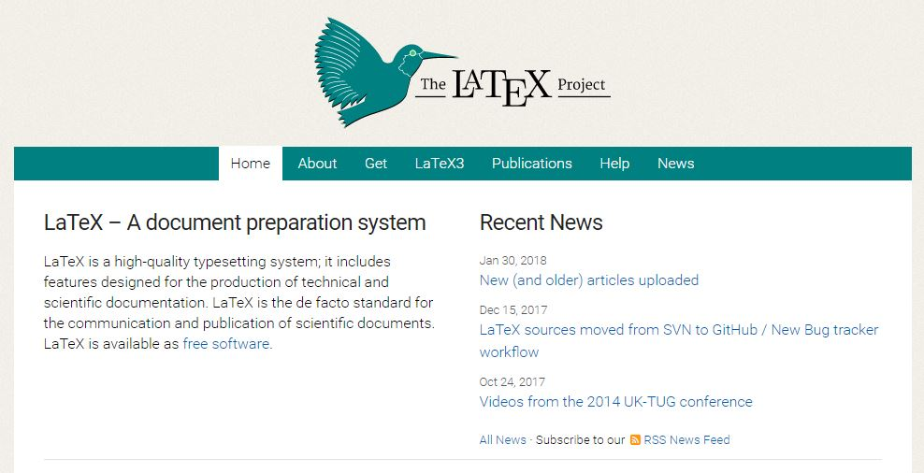
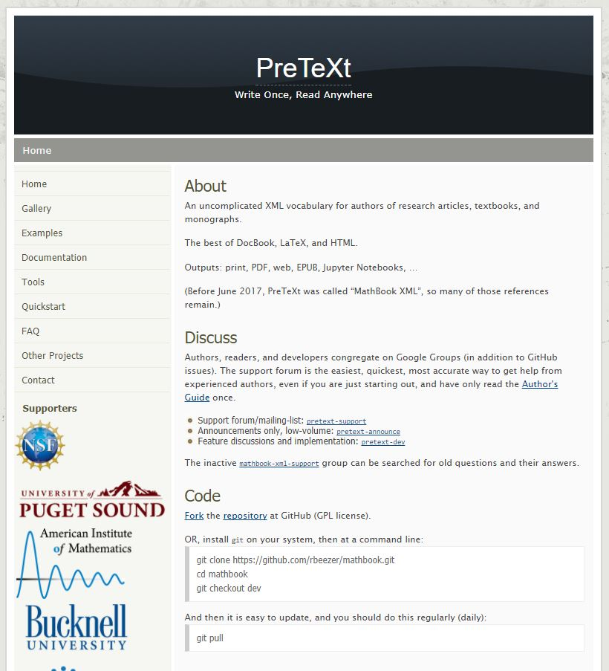
How we get there…
Write your own… I started by using LaTeX (https://www.latex-project.org/)
PreTeXt: Write Once, Read Anywhere (http://mathbook.pugetsound.edu/)
XML
Supports Sage (http://www.sagemath.org/)
Support
Online schema
Online Author Guide
Online Publisher Guide (New)
Google-Group Support Community
HTML
LaTeX PDF
ePUB
Jupyter Notebooks

Slide 9
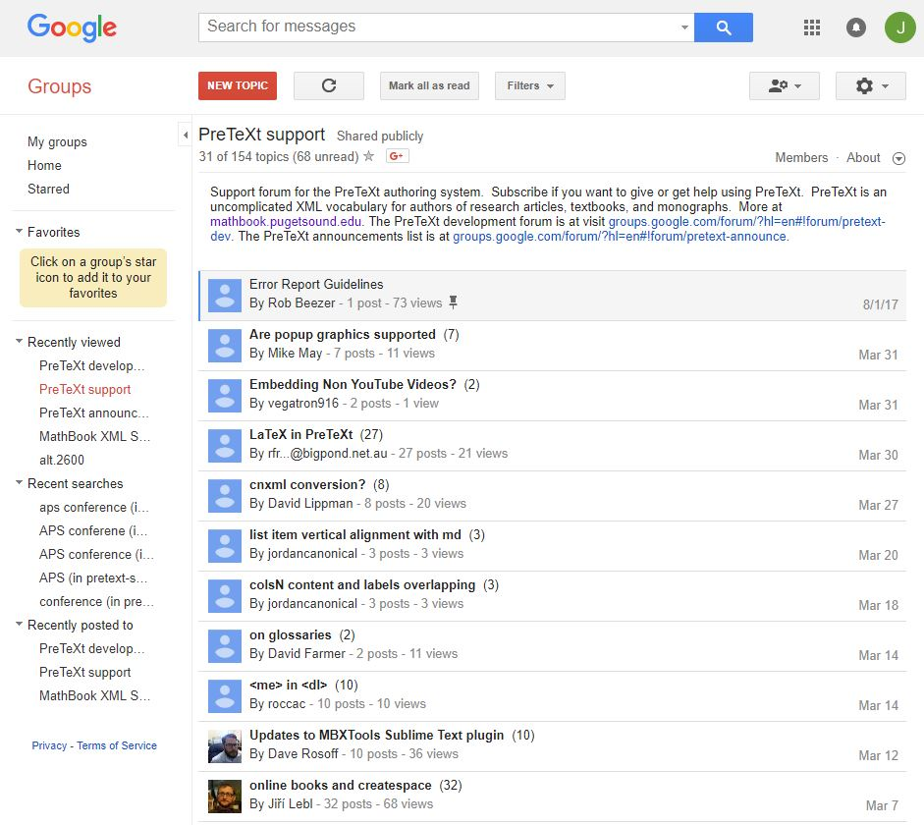
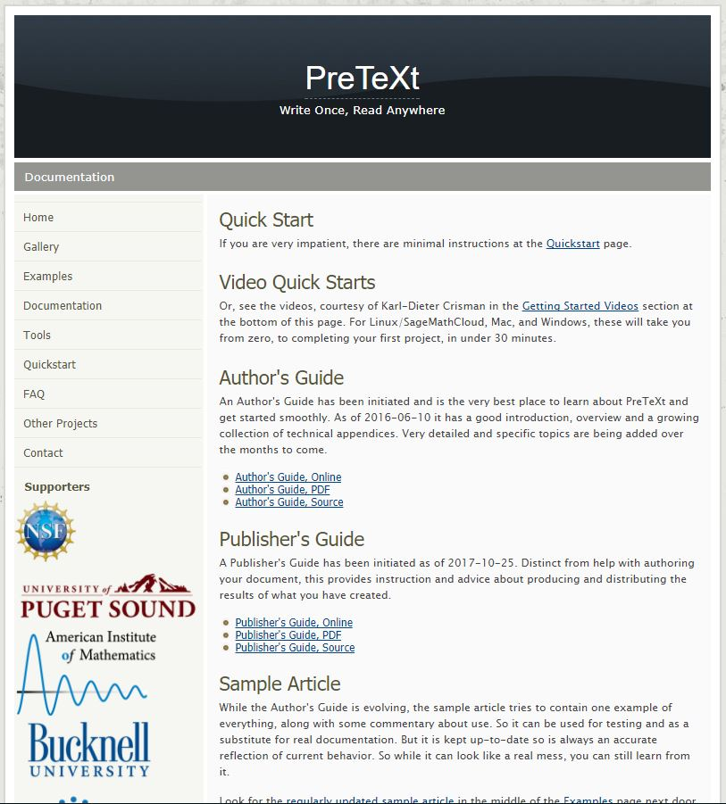
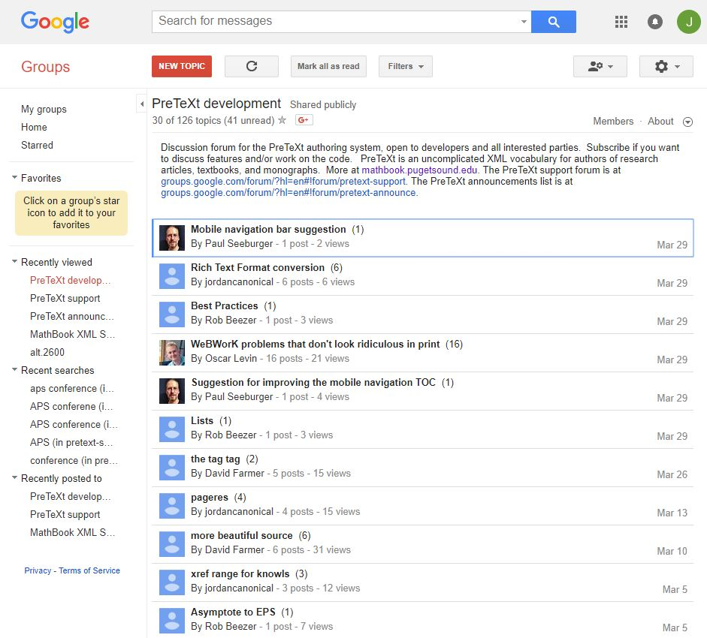
Open source self-publishing with community support

Slide 10
PreTeXt Open Source Gallery
Math, Lower Division
Algebra
Modeling, Functions, and Graphs
ORCCA (Open Resources)
Game Theory
A First Course in Linear Algebra
Calculus
Active Calculus
CLP Calculus (UBC)
Modeling
The ODE Project
Discrete Mathematics
Workbooks
Math, Upper Division
Number Theory
Combinatorics
Applied Combinatorics
Combinatorics through Guided Discovery
A Second Course in Linear Algebra
Abstract Algebra
Theory and Applications
A Structural Approach
Math, Graduate
Explorations in Algebraic Graph Theory with Sage
Need more physicists, please!

Slide 11
Compare LaTeX to PreTeXt
Furthermore the resulting direction of the net force determines the direction of the acceleration. Connecting the English and the math:</p>
<sidebyside>
<tabular>
<col width="20%" /><col width="20%" /><col width="20%" /><col width="20%" />
<row halign="center">
<cell><m>\deq \vec F_\mathrm{net} </m></cell>
<cell><m> =</m></cell>
<cell><m>\deq m</m></cell>
<cell><m>\deq \vec a</m></cell>
</row>
<row halign="center">
<cell><m>\overbrace{\hspace{5em}}</m></cell>
<cell><m>\overbrace{\hspace{4em}}</m></cell>
<cell><m>\overbrace{\hspace{5em}}</m></cell>
<cell><m>\overbrace{\hspace{5em}}</m></cell>
</row>
<row halign="center">
<cell><line>the</line><line>combination</line>
<line>of all forces</line>
<line>acting on <m>m</m></line></cell>
<cell>causes</cell>
<cell><line>that</line><line>object</line></cell>
<cell><line>to</line><line>change</line><line>its</line>
<line>velocity</line></cell>
</row>
</tabular>
</sidebyside>
</statement>
</heuristic>
<proposition xml:id="connect-Fma"><title>Looking Back</title>
<p>You should <xref ref="s-acceleration" text="title">recall</xref>, that the direction of the acceleration does not determine the direction <em>of the motion</em>, but rather determines the direction <em>of the change</em> in motion.</p>
</proposition>
<proposition xml:id="connect-Fma-ahead"><title>Looking Ahead</title>
<p>That idea will be important when we discuss how a <xref ref="s-FT" text="title">tension</xref> acts as a <xref ref="s-centripetal" text="title">centripetal force</xref>,
\hyperref[s:acceleration]{recall}
<xref ref=“s-acceleration” text=“title”>recall</xref>
Furthermore the resulting direction of the net force determines the direction of the acceleration. \hypertarget{d:f=ma}{Connecting the English} and the math:
\[\begin{array}{cccc}
\deq \vec F_\mathrm{net} & = & \deq m & \deq \vec a \\
\EqStoryOver{65pt}{the combination of all forces acting on $m$}{}
& \EqStoryOver{33pt}{causes}{}
& \EqStoryOver{35pt}{that object}{}
& \EqStoryOver{40pt}{to change its velocity}{}
\end{array}\]
You should \hyperref[s:acceleration]{recall}\touchstone, that the direction of the acceleration does not determine the direction \textit{of the motion}, but rather determines the direction \textit{of the change} in motion. That idea will be important\foreshadow{} when we discuss how a \hyperref[s:FT]{tension} acts as a \hyperref[s:centripetal]{centripetal force},
\textit{of the motion}
<em>of the motion</em>
$\displaystyle \vec F_\mathrm{net}$
<m>\displaystyle \vec F_\mathrm{net}</m>
$m$ → <m>m</m>

Slide 12
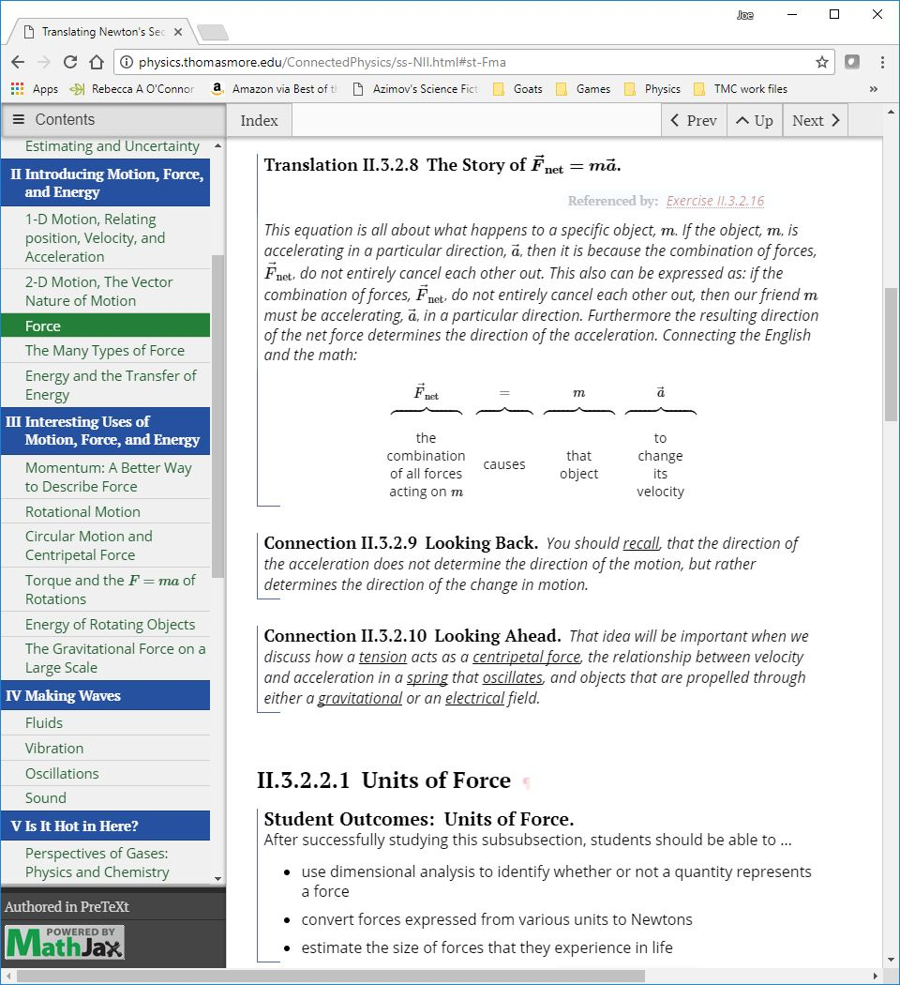
physics.thomasmore.edu/ConnectedPhysics/
physics.thomasmore.edu/ConnectedPhysics/

Slide 13
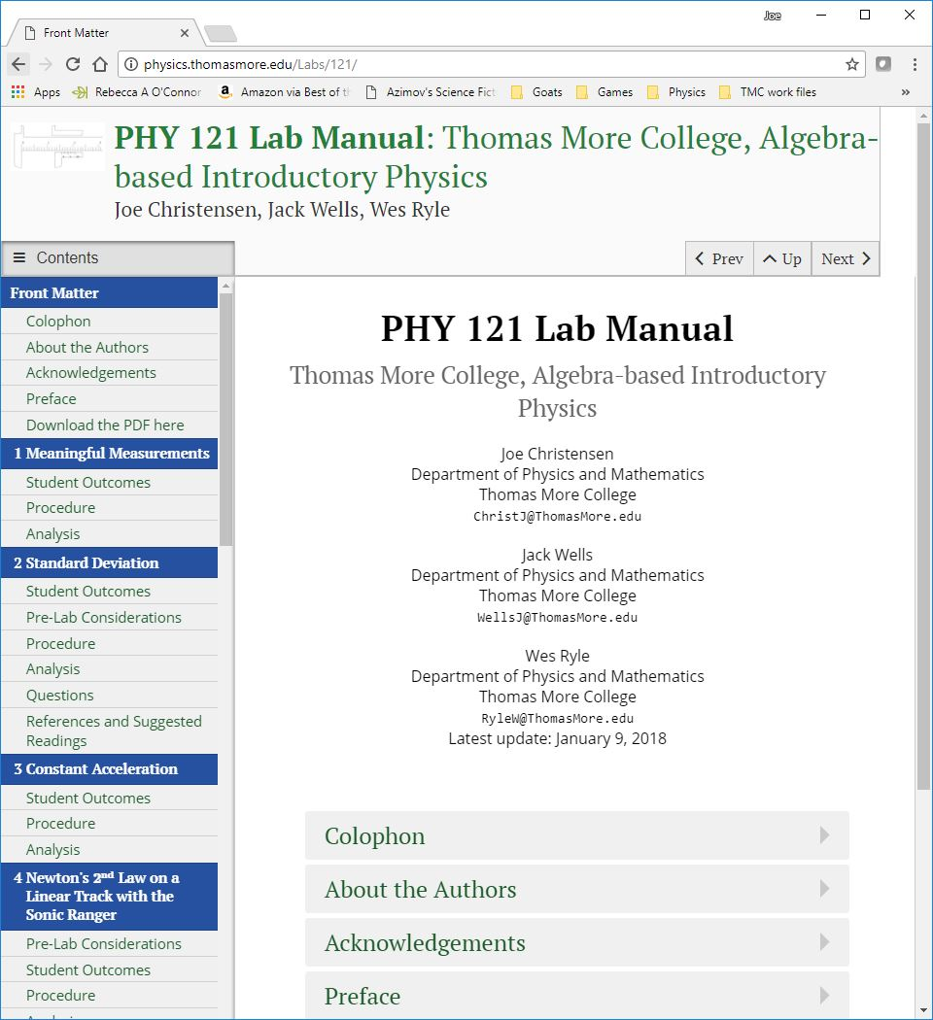
Explore the lab manual
PHY 121 Lab Manual

Slide 14
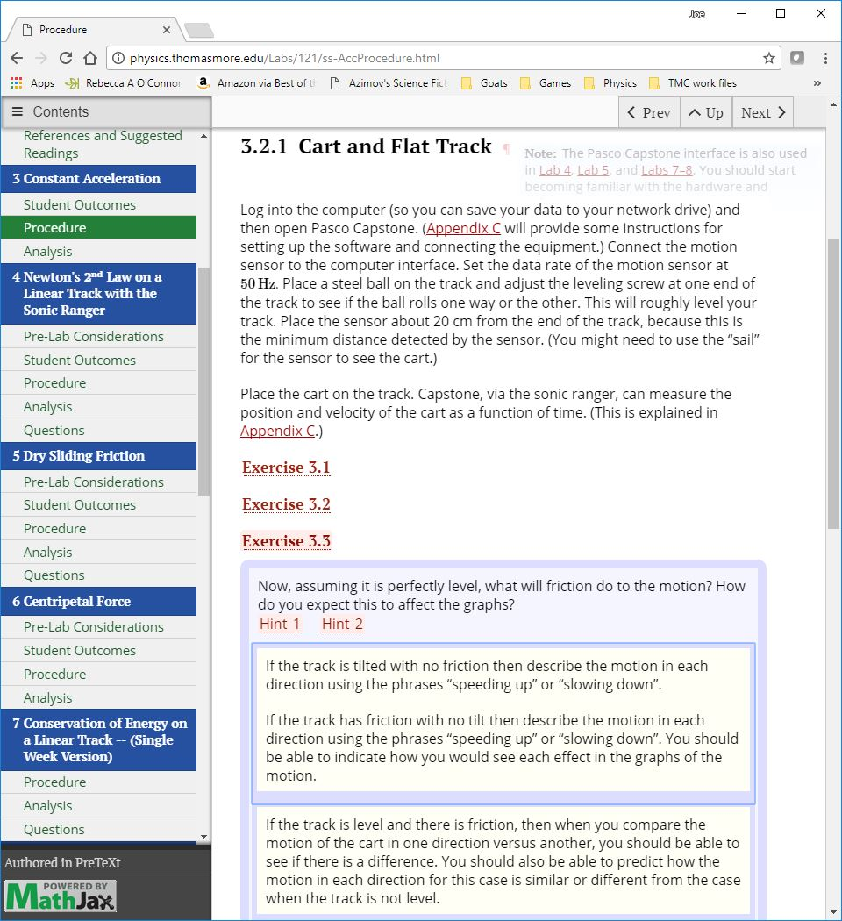
Explore the lab manual
PHY 121 Lab Manual
Constant Acceleration
Procedure; Exercise 3.3 (Hints)

Slide 15
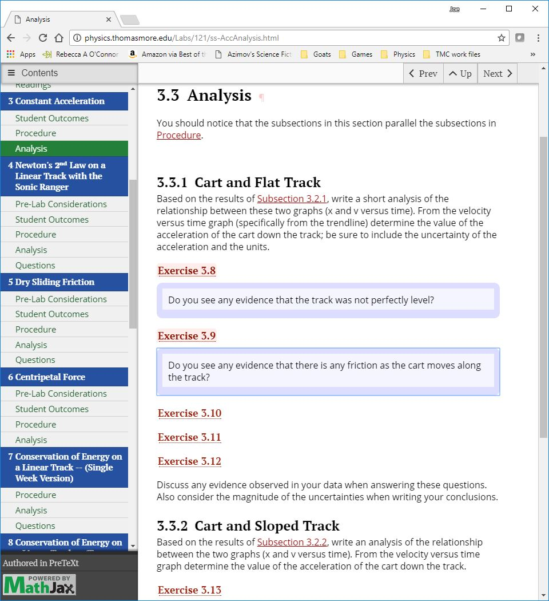
Explore the lab manual
PHY 121 Lab Manual
Constant Acceleration
Procedure; Exercise 3.3 (Hints)
Analysis; Exercises 8 & 9

Slide 16
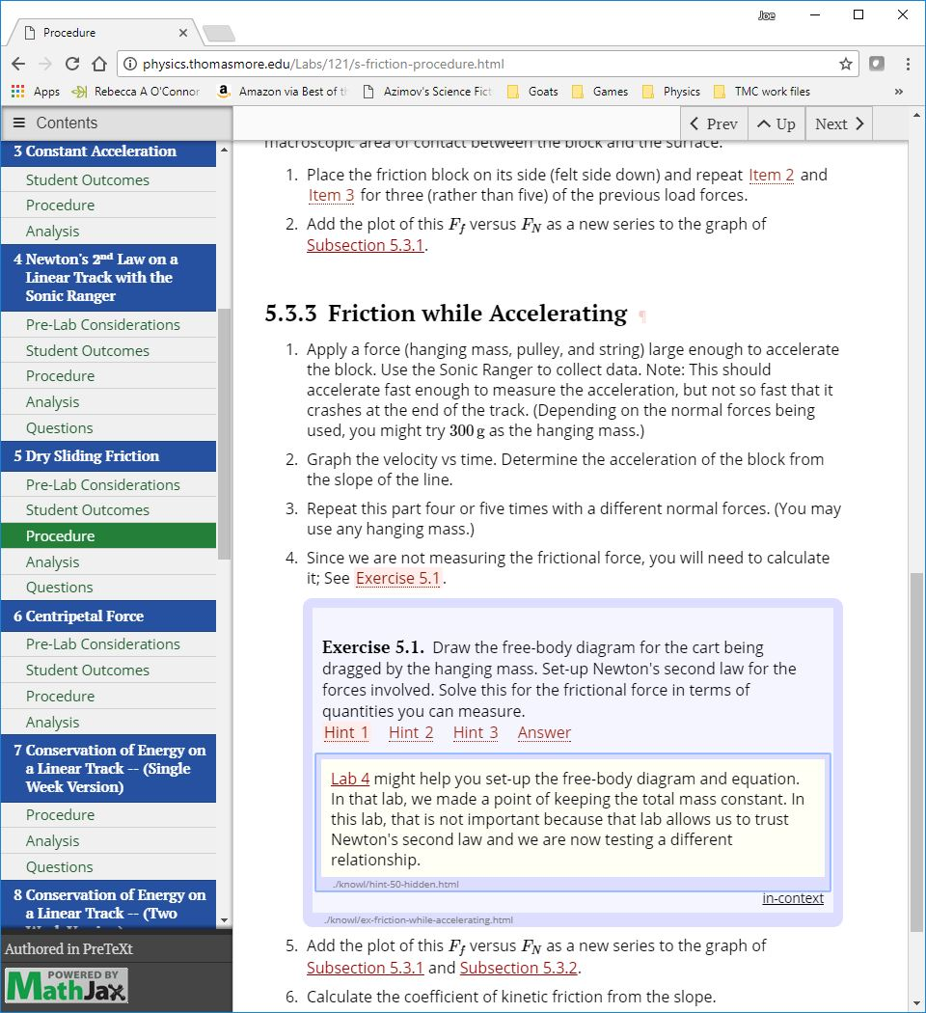
Explore the lab manual
PHY 121 Lab Manual
Constant Acceleration
Procedure; Exercise 3.3 (Hints)
Analysis; Exercises 8 & 9
Friction
Exercises with Hints, Answers, and links to previous labs.

Slide 17
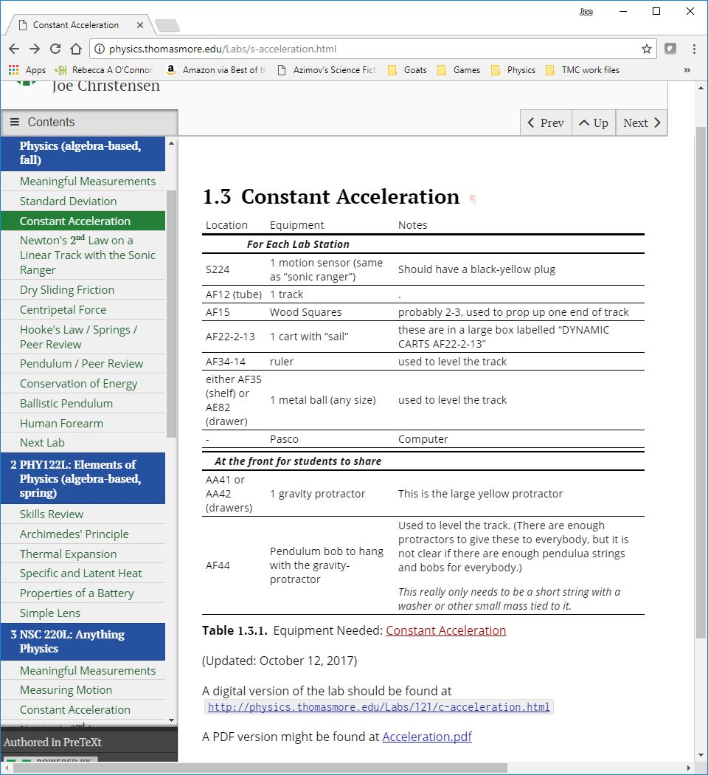
Explore the lab set-up instructions
PHY 121 Lab Manual
Constant Acceleration
Procedure; Exercise 3.3 (Hints)
Analysis; Exercises 8 & 9
Friction
Exercises with Hints, Answers, and links to previous labs.
Lab Setup Instructions
Locations
Pictures
Links to the Manual

Slide 18
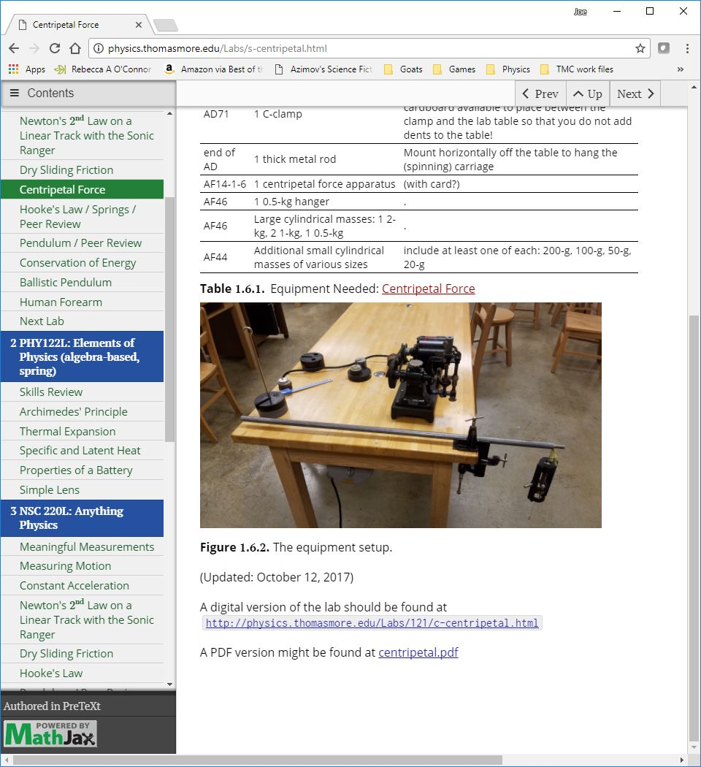
Explore the lab set-up instructions
PHY 121 Lab Manual
Constant Acceleration
Procedure; Exercise 3.3 (Hints)
Analysis; Exercises 8 & 9
Friction
Exercises with Hints, Answers, and links to previous labs.
Lab Setup Instructions
Locations
Pictures
Links to the Manual

Slide 19
Resources
Where we are
https://www.ck12.org/c/physics/#/
https://openstax.org/details/college-physics
LaTeX
General Info: https://www.latex-project.org/
MiKTeX: https://miktex.org/
Comprehensive TeX Archive Network: https://ctan.org/
PreTeXt
Source: http://mathbook.pugetsound.edu/
Sage: http://www.sagemath.org/
Author Guide:
http://mathbook.pugetsound.edu/doc/author-guide/html/pretext-author-guide.html
Publisher Guide:
http://mathbook.pugetsound.edu/doc/publisher-guide/html/pretext-publisher-guide.html
PreTeXt schema:
http://mathbook.pugetsound.edu/doc/schema/
Google-Group Support Community:
https://groups.google.com/forum/?utm_source=digest&utm_medium=email#!forum/pretext-support
My [Draft] Book: Connected Physics
http://physics.thomasmore.edu/ConnectedPhysics/
(If you are interested in collaborating, please contact ChristJ@ThomasMore.edu)
Lab Manuals
http://physics.thomasmore.edu/Labs/121/
http://physics.thomasmore.edu/Labs/122/
http://physics.thomasmore.edu/Labs/220/
Lab Set-up Instructions
http://physics.thomasmore.edu/Labs/TMC-lab-setup.html

